Slide 1


Slide 2
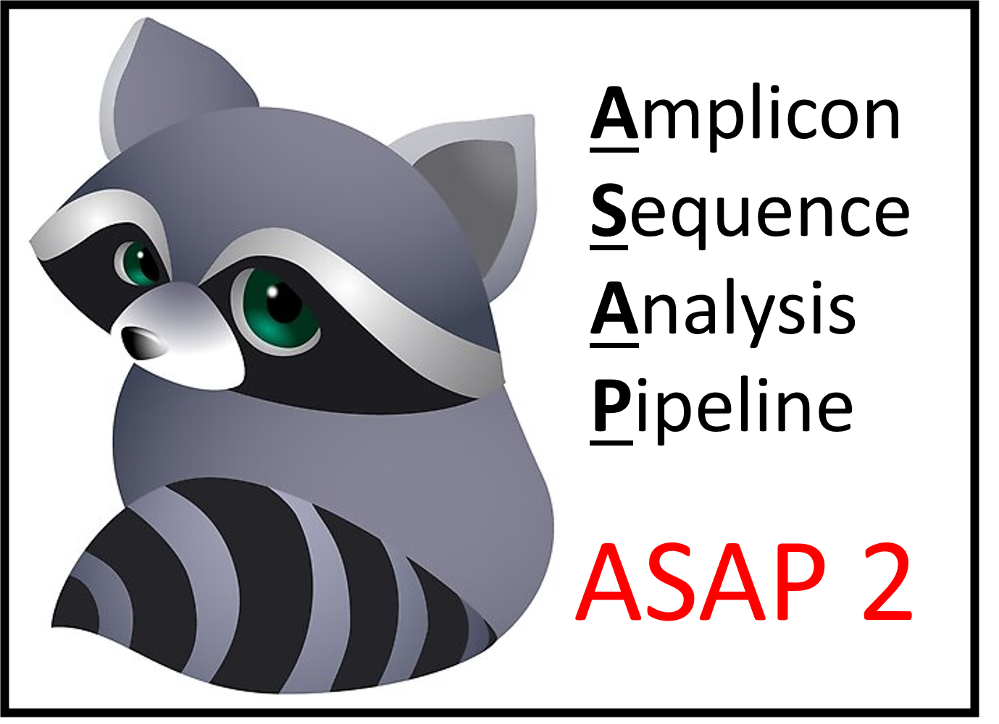
ASAP 2, A Metagenomic Analytical Tool for Pathogen Detection in The Environment
Renmao Tian
Research Scientist; High Throughput Initiative;
Institute for Food Safety and Health; IIT

Slide 3
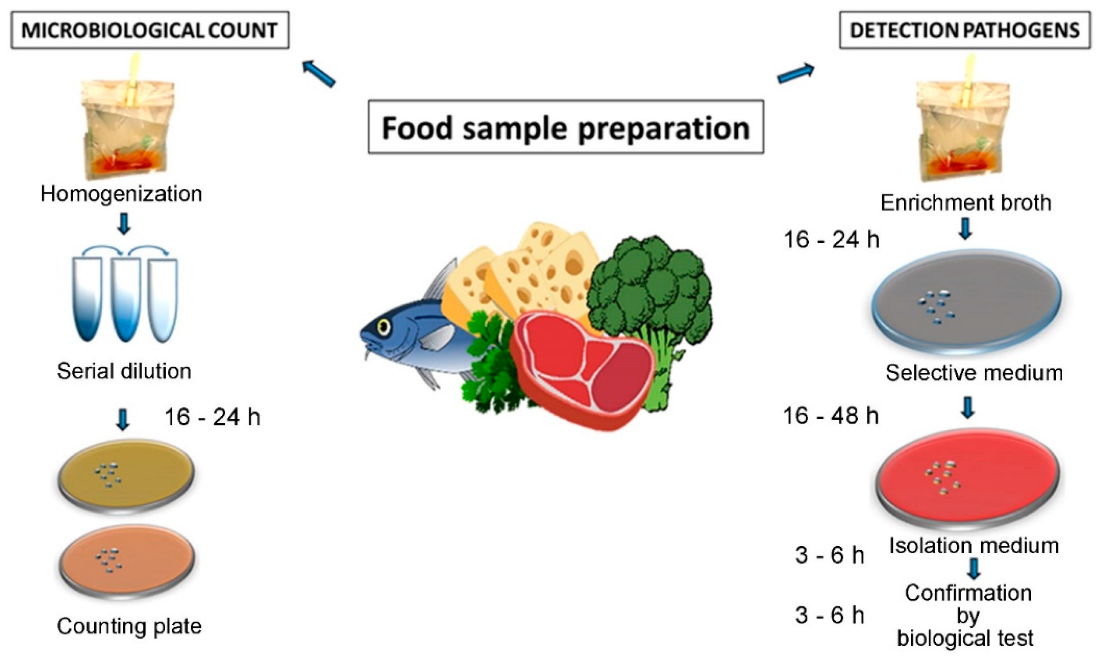
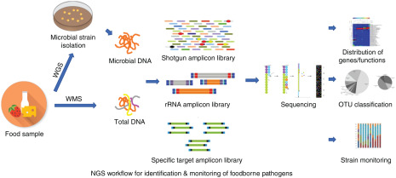
Food-borne pathogen detection
Culture-dependent detection
Culture-independent detection

Slide 4
Marker gene amplicon sequencing
Used for detection of uncultured microorganisms
Food industry: detection of food-borne pathogens using 16S rRNA gene
Environmental research: ecological function and interaction of microbes using 16S rRNA, dsrA, nifH etc
Medical research: human microbiome (e.g. gut microbiota) connected to human health

Slide 5
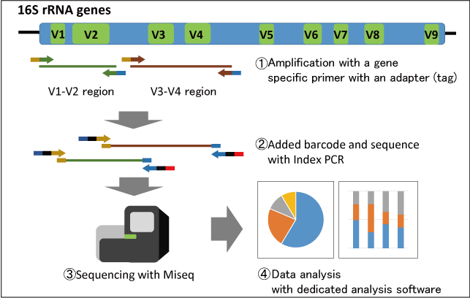
16S rRNA gene amplicon sequencing
https://www.repertoire.co.jp/en/research/technology/16srrnainfo/

Slide 6
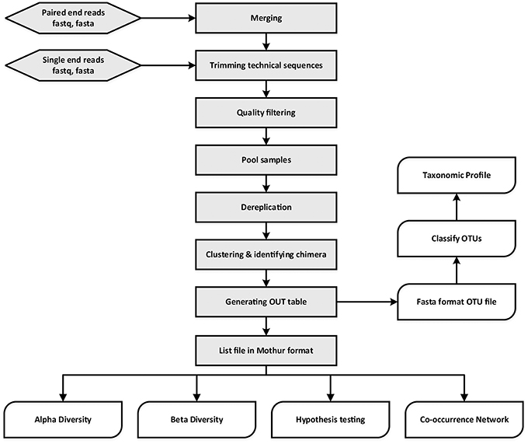
Analysis workflow of amplicon sequencing data
*
Demultiplexing
Raw data
*
Is it too complicated for you?
https://www.frontiersin.org/articles/10.3389/fmicb.2017.01461/full

Slide 7
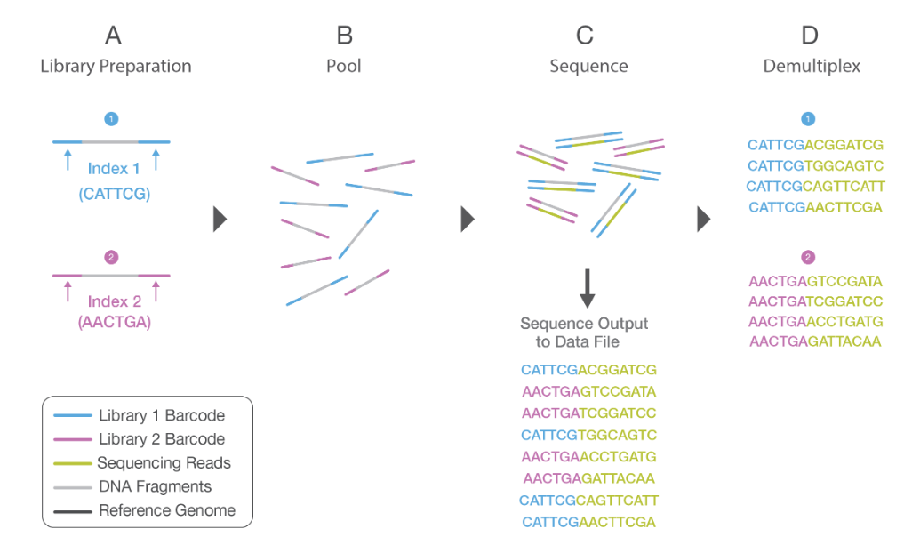
Demultiplexing

Slide 8
Operational taxonomic units (OTUs)
Definition: a cluster of reads that differ from each other by less than an arbitrary threshold (e.g. 3%).
It is used for diversity evaluation with error-prone sequences.
Generation of OTUs
De novo method
Reference-based method
Tools: UCLUST UPARSE Swarm SortMeRNA
Cons: low resolution

Slide 9
Amplicon sequence variant (ASV)
Definition: single sequence variant
Due to advances in sequencing technologies and post-sequencing error correction algorithms
Tools to identify ASV: DADA2, UNOISE2 Deblur etc.
Pros:
High resolution
Comparable in multiple data sets

Slide 10

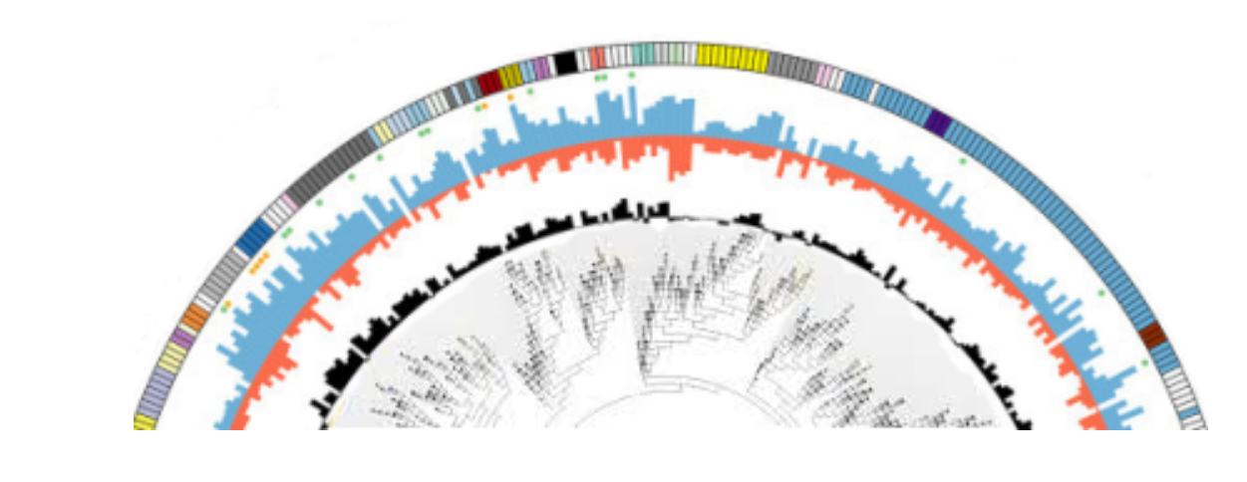
Pipelines for amplicon sequence analysis
DADA 2
MetaAmp
https://qiime2.org/
https://benjjneb.github.io/dada2/tutorial.html
http://ebg.ucalgary.ca/metaamp/
However, these tools require much human interference.
Automation: users need to run step by step
Demultiplexing: users need to check the orientation of barcodes
Quality trimming: users are required to select high-quality region
Resampling: users need to determine the optimal resampling depth

Slide 11
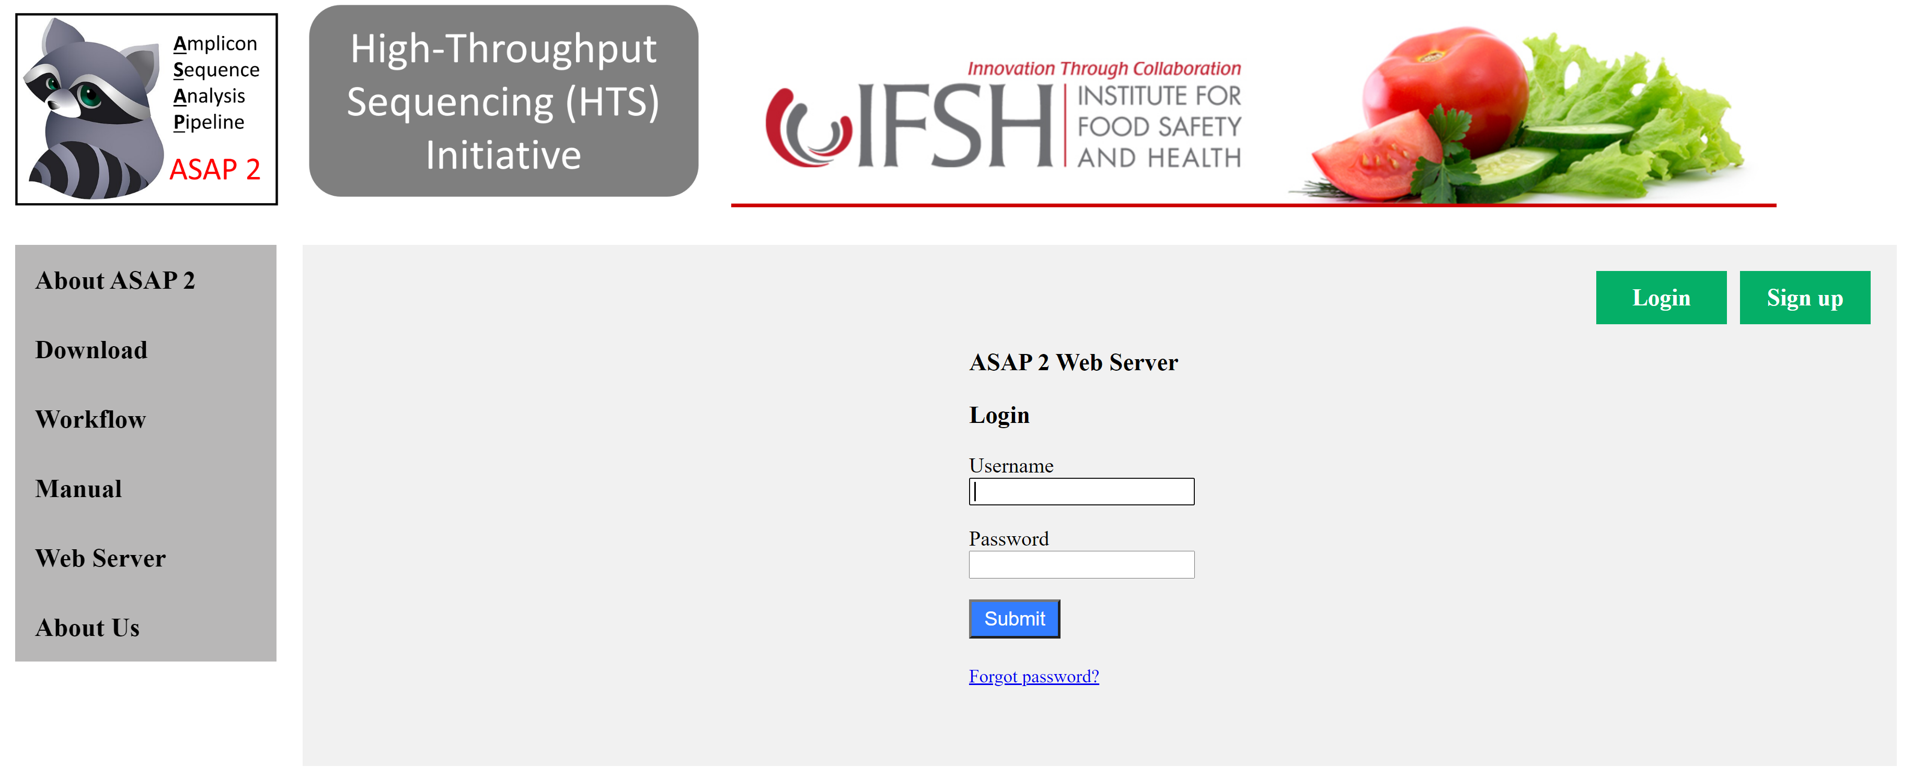
Amplicon sequence analysis pipeline (ASAP 2)

Slide 12
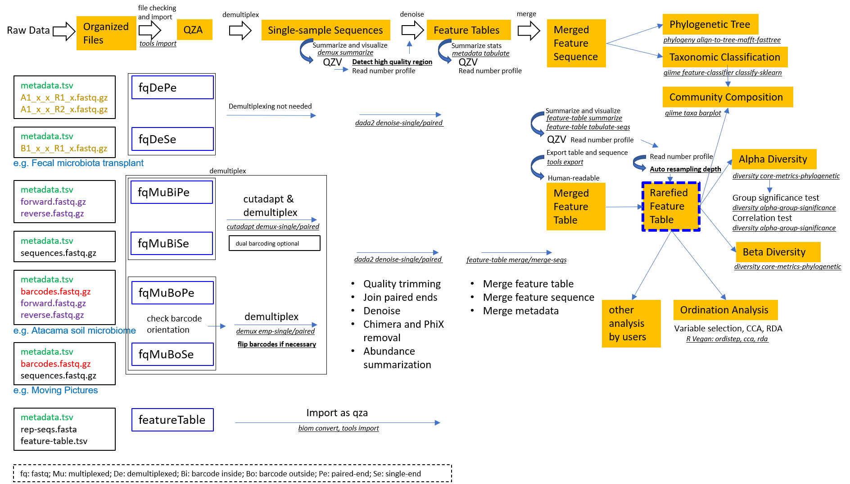
Workflow of the pipeline

Slide 13
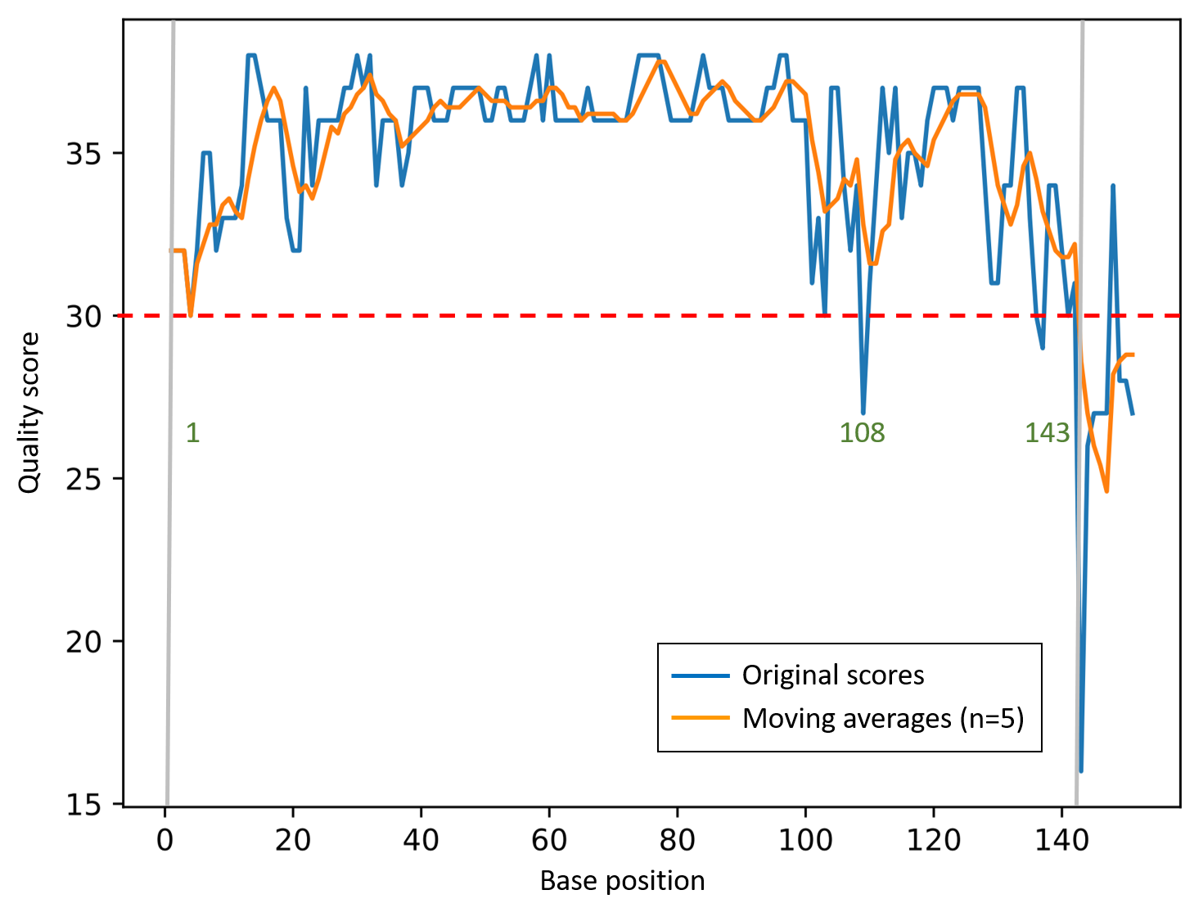
Auto detection of optimal high-quality region

Slide 14
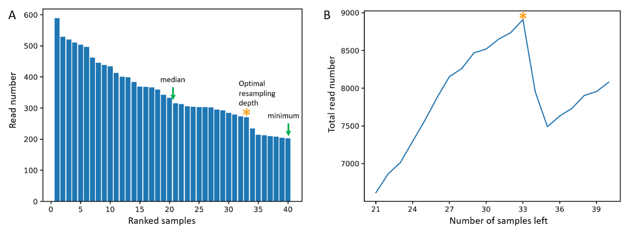
Automatic determination of the optimal resampling depth

Slide 15
ASAP 2 in comparison with other pipelines
 | QIIME 2 | DADA 2 | MetaAmp (OTU-based) | MetaAmp ASV-based) | ASAP 2
Feature | ASV | ASV | OTU | ASV | ASV
Supported formats | All * | Only demultiplexed sequences | Only demultiplexed sequences | Only demultiplexed sequences | All *
Barcode orientation identification | Manual | Manual | NA** | NA** | Auto
Combination of multiple projects | Manually merge feature tables | Manually merge feature tables | OTUs cannot be combined | Demultiplexed data as input | Auto merge feature tables
High-quality region identification | Manual | Manual | NA*** | Manual | Auto
Resampling depth | Manual | Manual | Manual | Manual | Auto

Slide 16
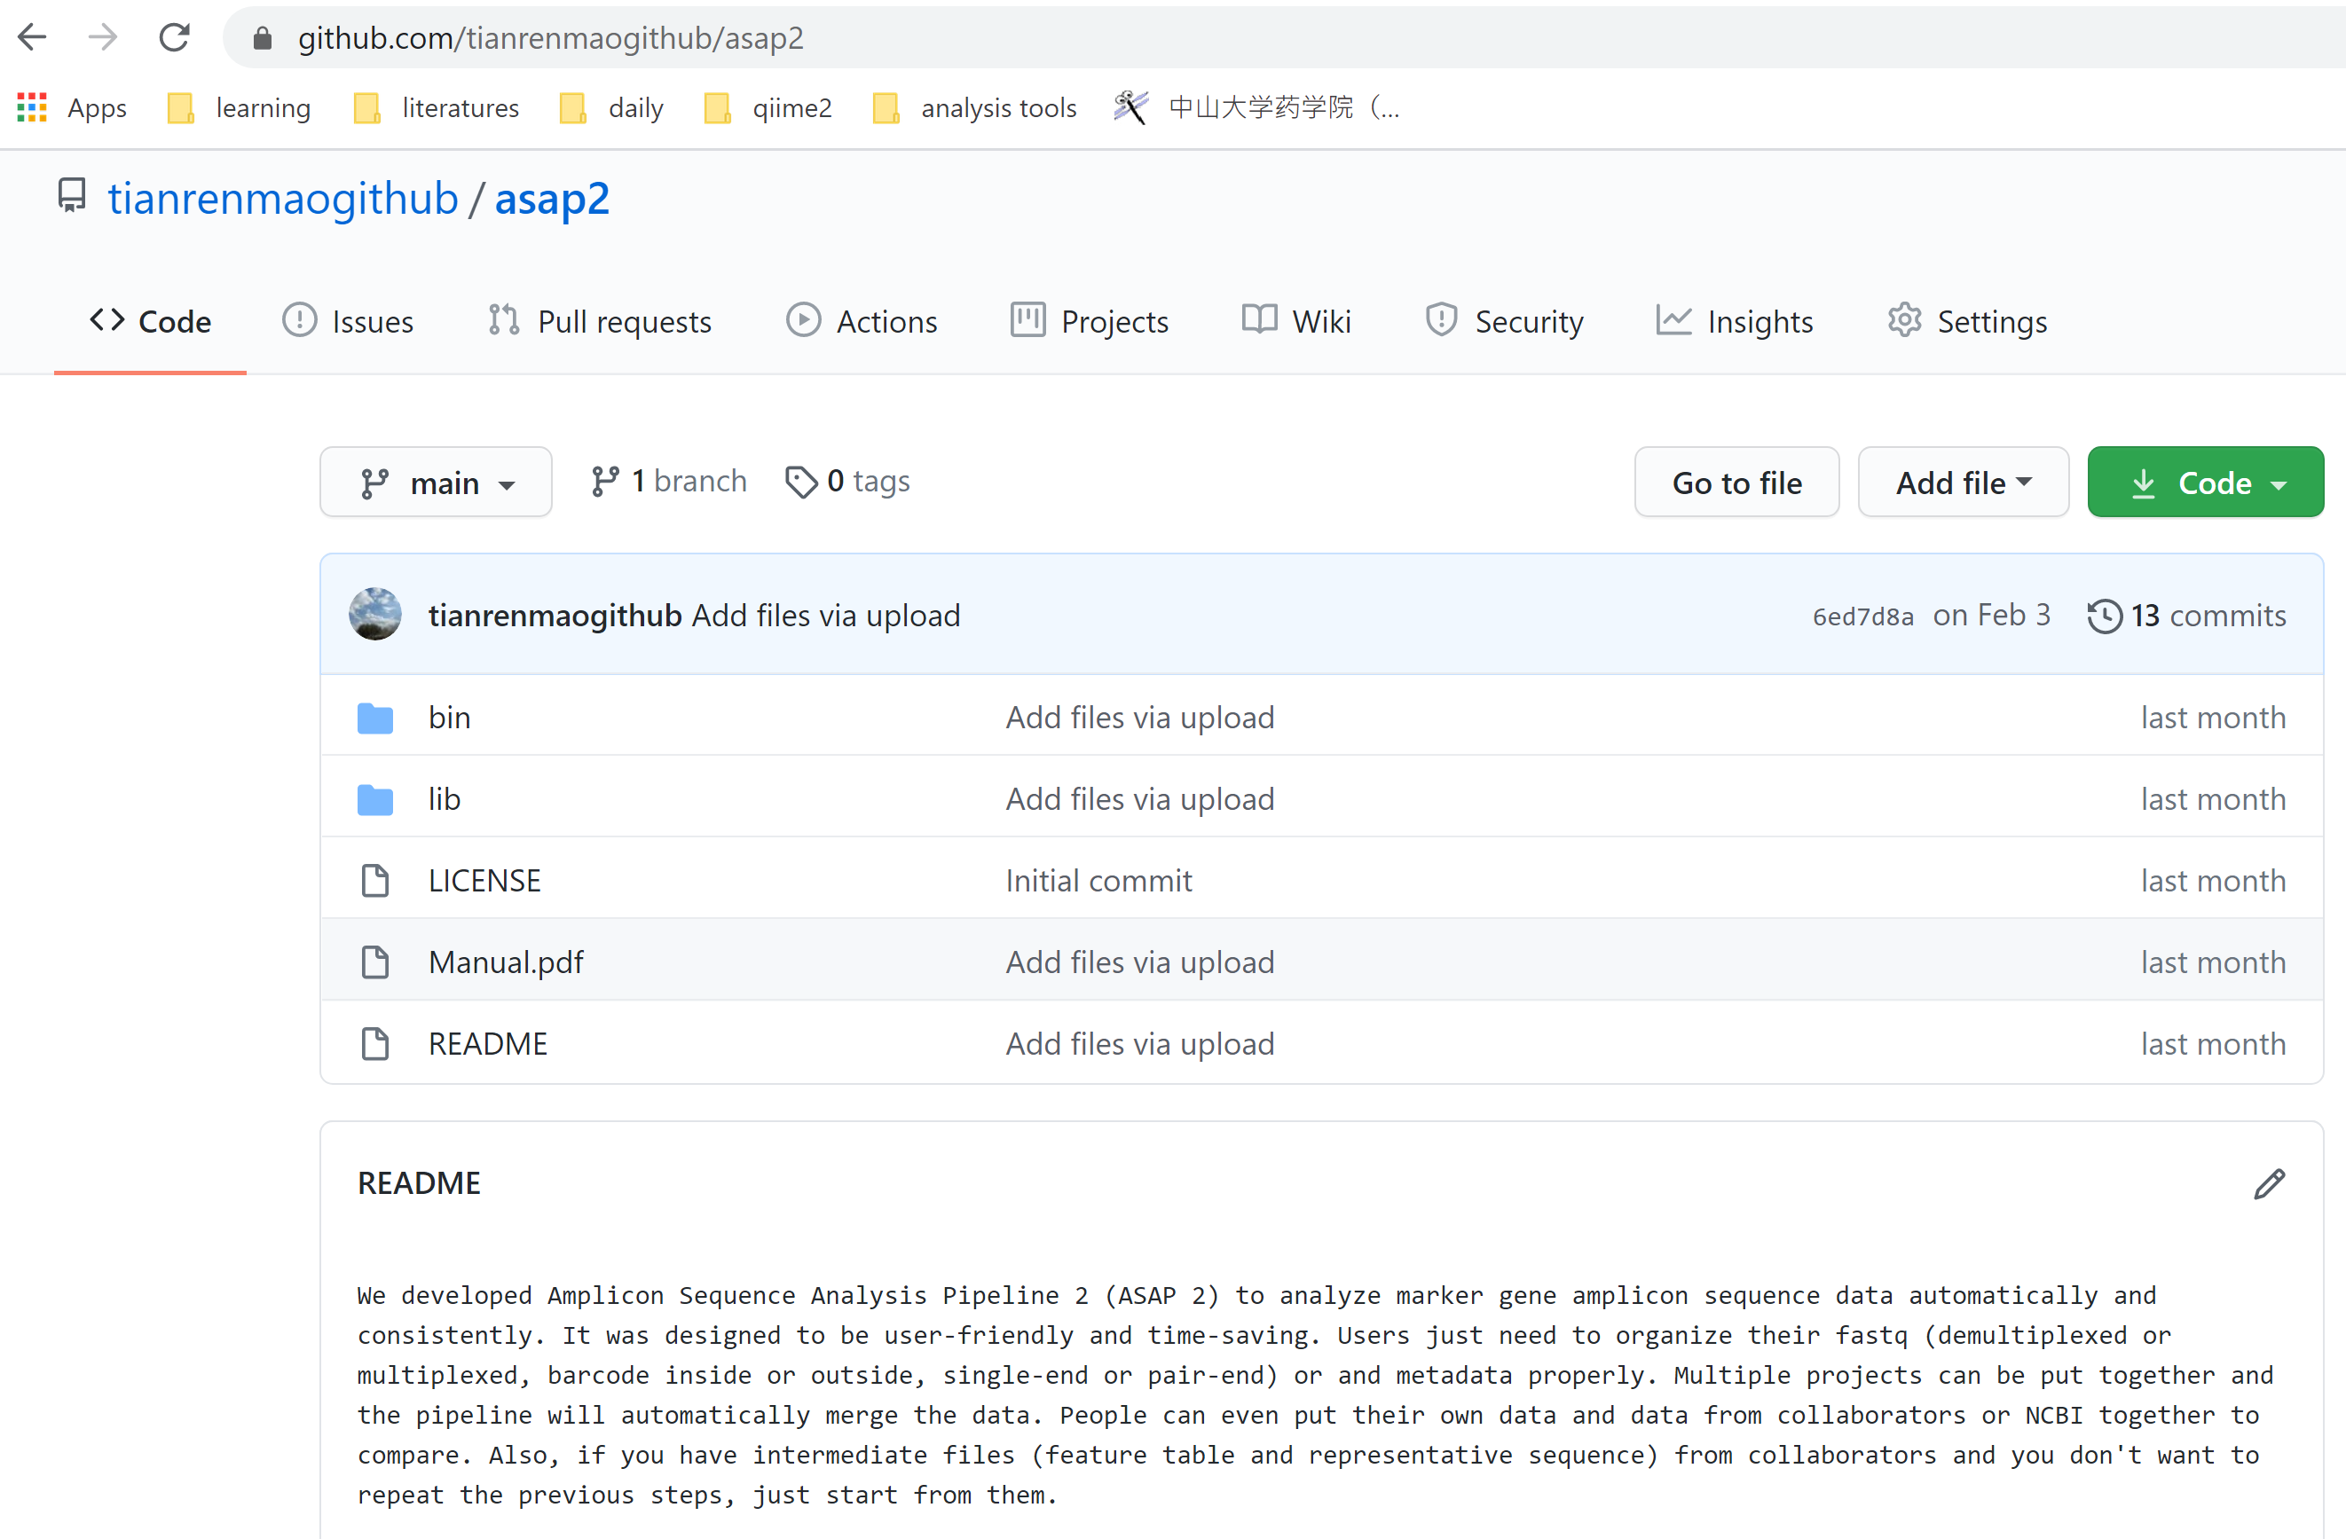
Pipeline source code

Slide 17
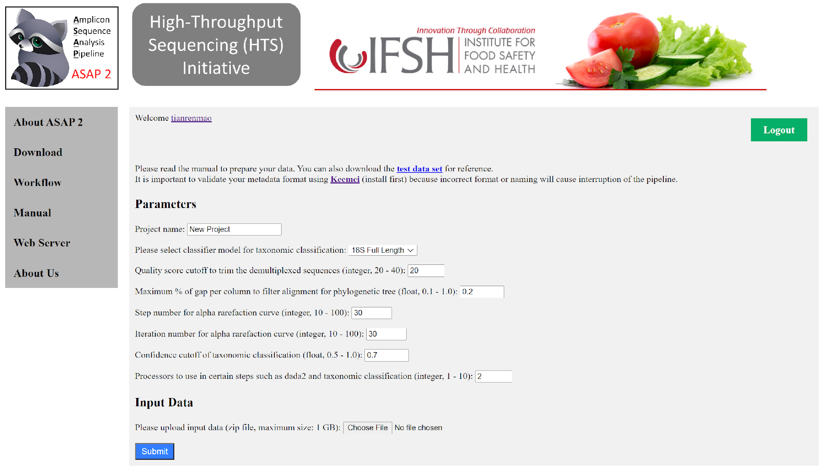
Web server interface

Slide 18
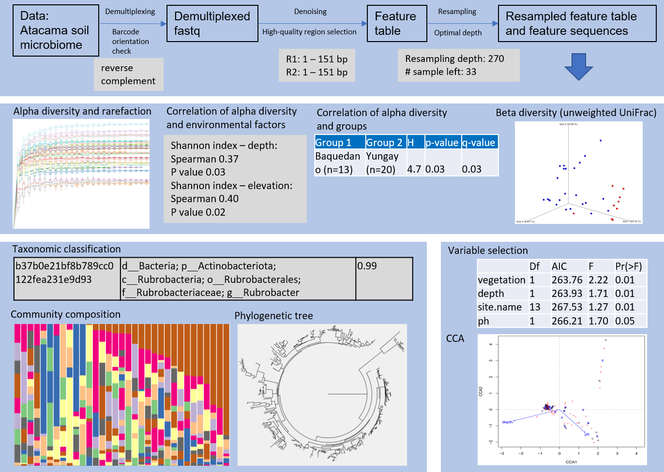
Demonstration results

Slide 19
Acknowledgement
I acknowledge Dr Behzad Imanian for his great supervision. We thank Institute for Food Safety and Health (IFSH) and Food and Drug Administration (FDA) of the U.S. Department of Health and Human Services (HHS) for supporting the research. Thanks to Renee and Ozzie for organizing the TCM seminar.

Slide 20
Q & A

